Slide 1
SYSTEM CALLS

Slide 2
System Calls
Programming interface to the services provided by the OS
Typically written in a high-level language (C or C++)
Mostly accessed by programs via a high-level Application Programming Interface (API) rather than direct system call use
Three most common APIs are Win32 API for Windows, POSIX API for POSIX-based systems (including virtually all versions of UNIX, Linux, and Mac OS X), and Java API for the Java virtual machine (JVM)

Slide 3
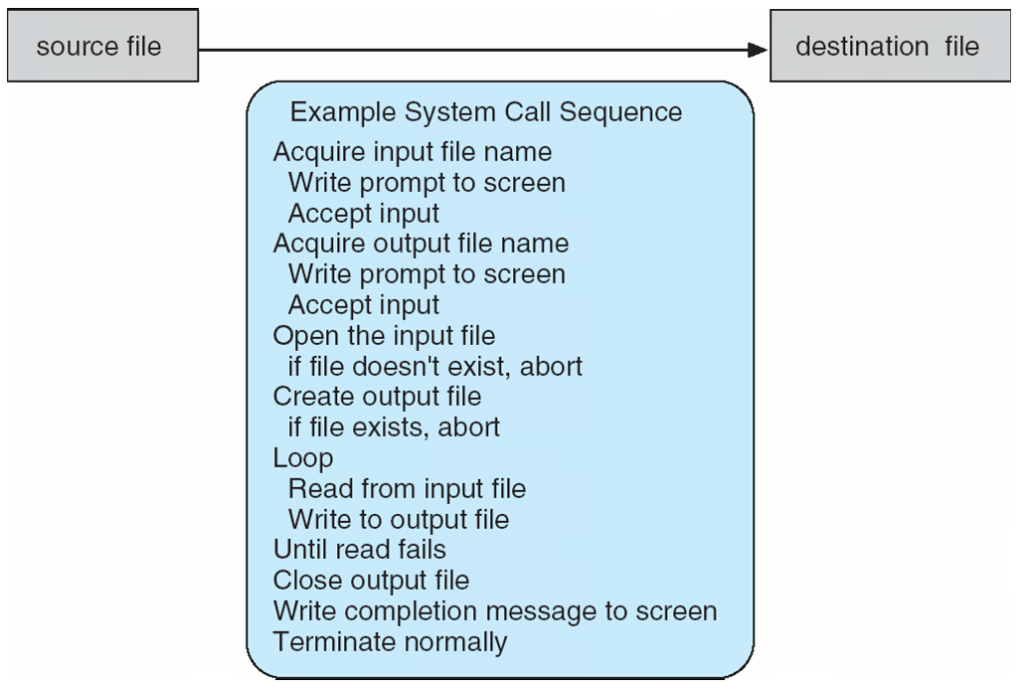
Example of System Calls
System call sequence to copy the contents of one file to another file

Slide 4
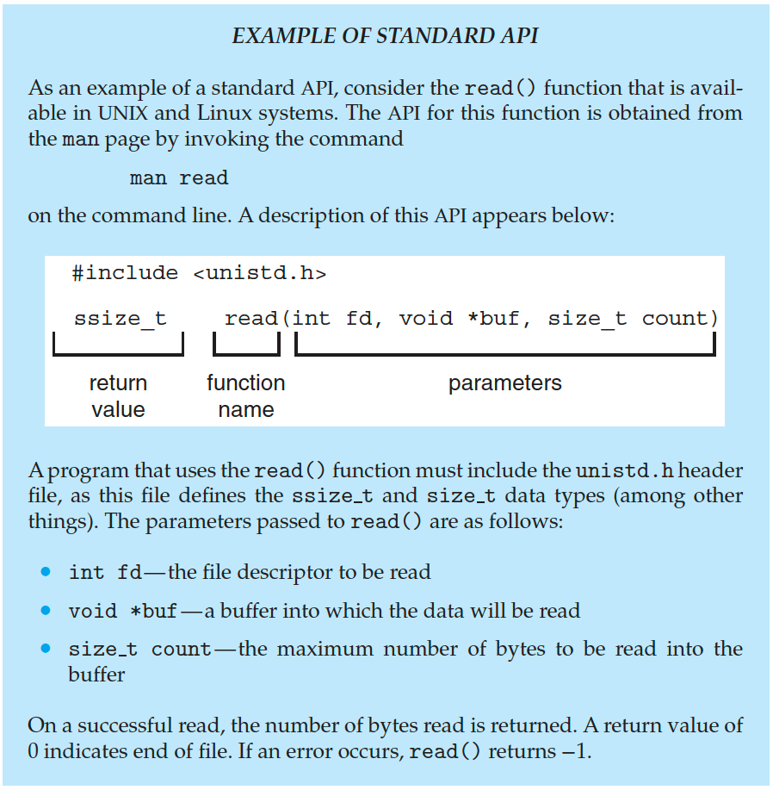
Example of Standard API

Slide 5
System Call Implementation
Typically, a number is associated with each system call
System-call interface maintains a table indexed according to these numbers
The system call interface invokes the intended system call in OS kernel and returns status of the system call and any return values
The caller need know nothing about how the system call is implemented
Just needs to obey API and understand what OS will do as a result call
Most details of OS interface hidden from programmer by API
Managed by run-time support library (set of functions built into libraries included with compiler)

Slide 6
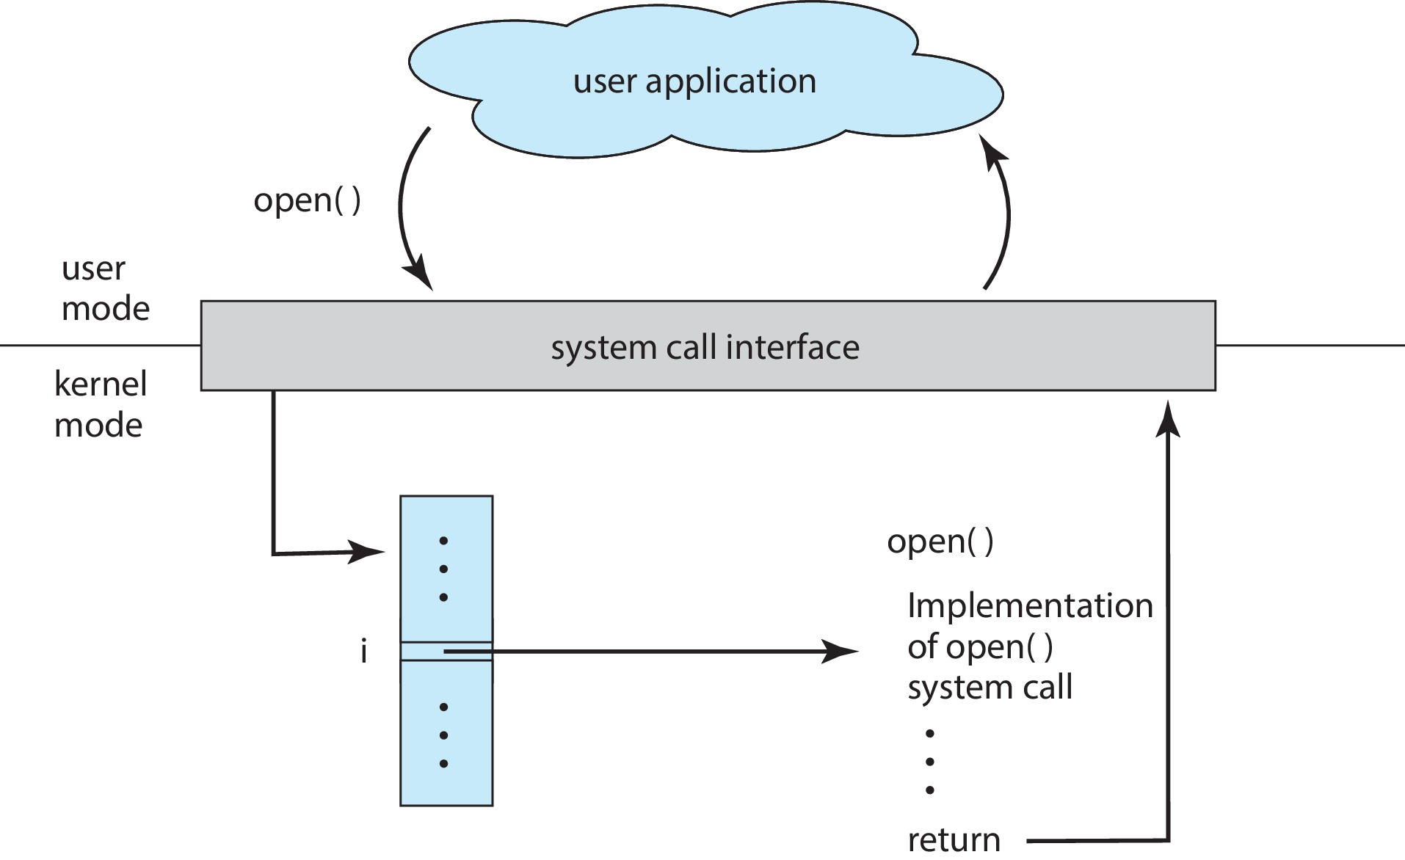
API – System Call – OS Relationship

Slide 7
System Call Parameter Passing
Often, more information is required than simply identity of desired system call
Exact type and amount of information vary according to OS and call
Three general methods used to pass parameters to the OS
Simplest: pass the parameters in registers
In some cases, may be more parameters than registers
Parameters stored in a block, or table, in memory, and address of block passed as a parameter in a register
This approach taken by Linux and Solaris
Parameters placed, or pushed, onto the stack by the program and popped off the stack by the operating system
Block and stack methods do not limit the number or length of parameters being passed

Slide 8
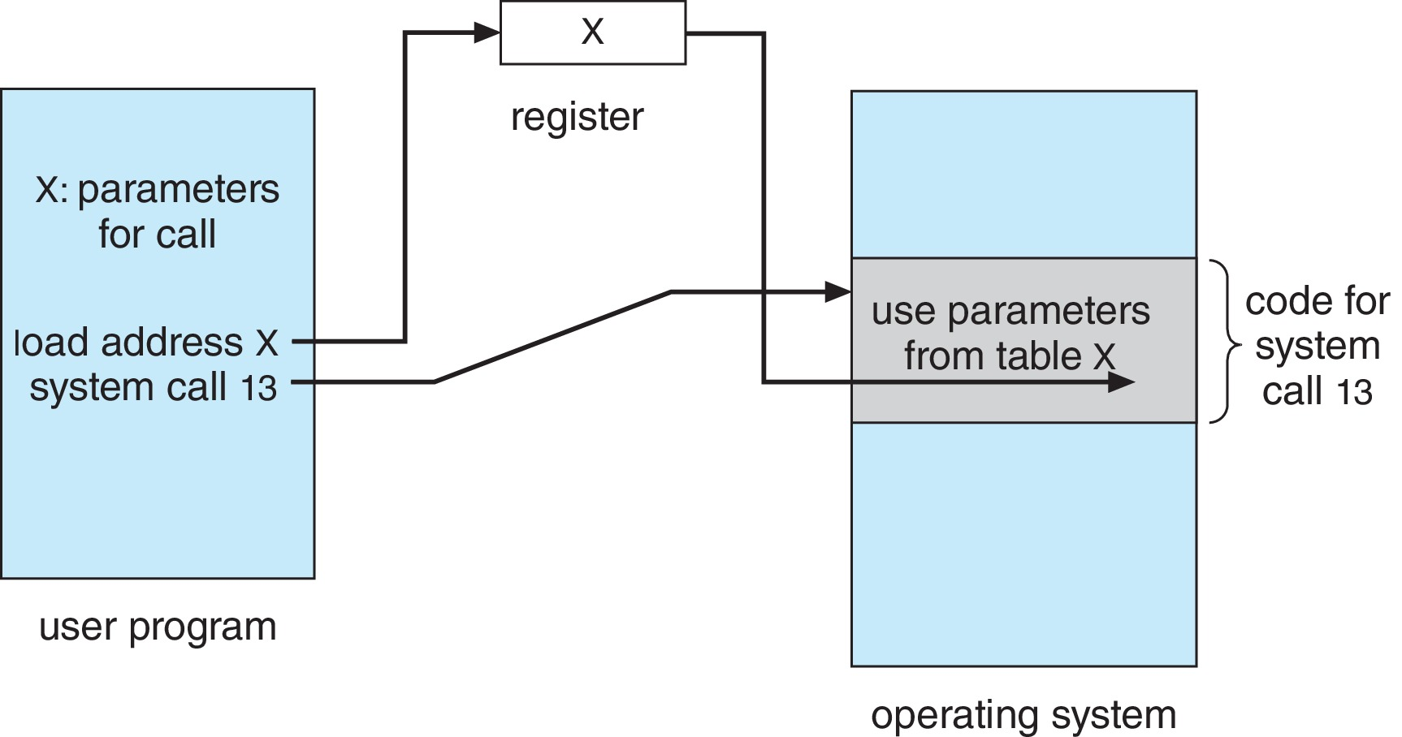
Parameter Passing via Table

Slide 9
Types of System Calls
Process control
create process, terminate process
end, abort
load, execute
get process attributes, set process attributes
wait for time
wait event, signal event
allocate and free memory
Dump memory if error
Debugger for determining bugs, single step execution
Locks for managing access to shared data between processes

Slide 10
Types of System Calls
Six Categories
a. Process control
b. File manipulation
c. Device manipulation
d. Information maintenance
e. Communications
f. Protection

Slide 11
Types of System Calls (Cont.)
File management
create file, delete file
open, close file
read, write, reposition
get and set file attributes
Device management
request device, release device
read, write, reposition
get device attributes, set device attributes
logically attach or detach devices

Slide 12
Types of System Calls (Cont.)
Information maintenance
get time or date, set time or date
get system data, set system data
get and set process, file, or device attributes
Communications
create, delete communication connection
send, receive messages if message passing model to host name or process name
From client to server
Shared-memory model create and gain access to memory regions
transfer status information
attach and detach remote devices

Slide 13
Types of System Calls (Cont.)
Protection
Control access to resources
Get and set permissions
Allow and deny user access

Slide 14
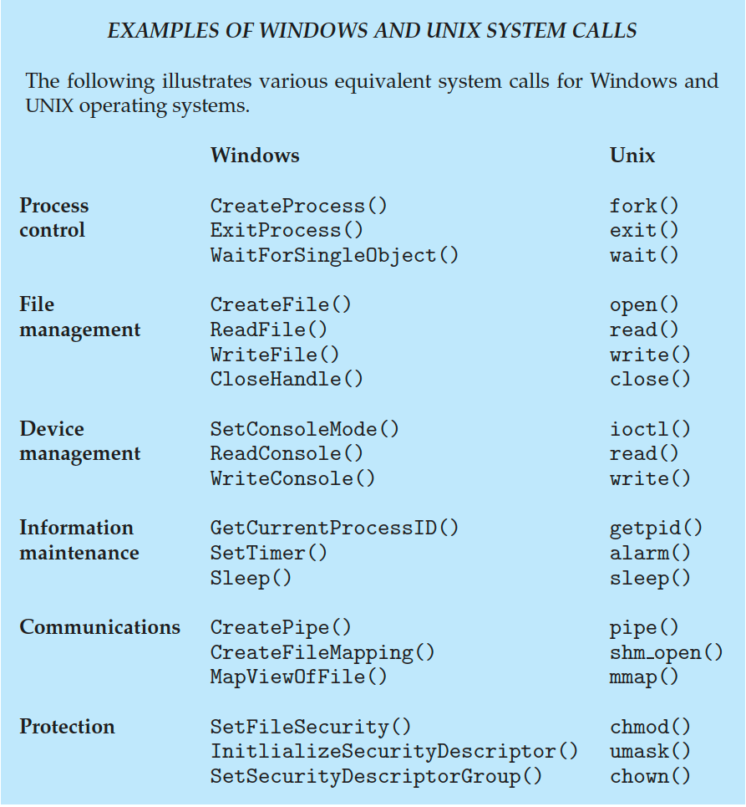
Examples of Windows and Unix System Calls

Slide 15
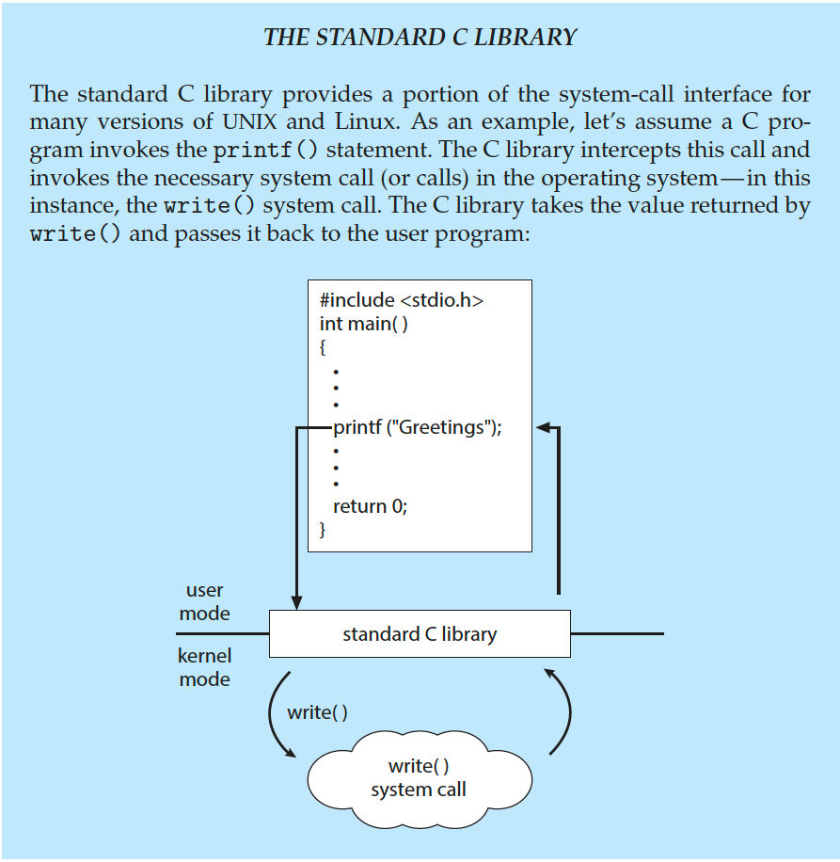
Standard C Library Example
C program invoking printf() library call, which calls write() system call

Slide 16
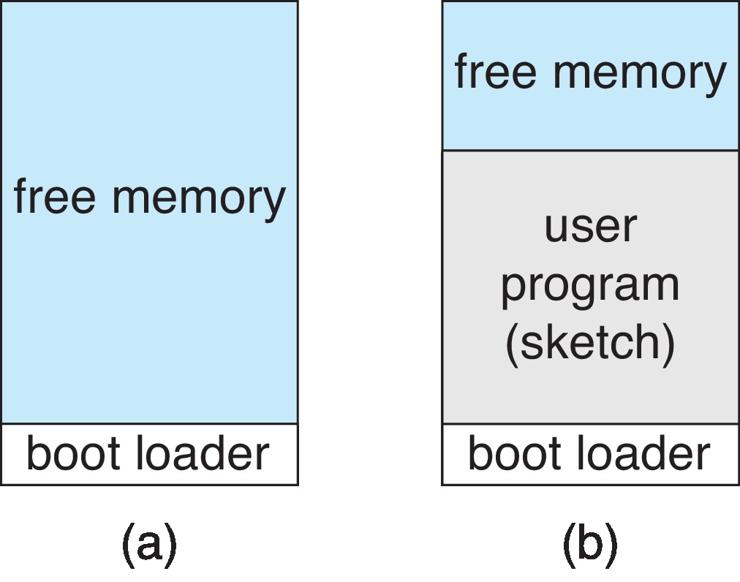
Example: Arduino
Single-tasking
No operating system
Programs (sketch) loaded via USB into flash memory
Single memory space
Boot loader loads program
Program exit -> shell reloaded
At system startup running a program

Slide 17
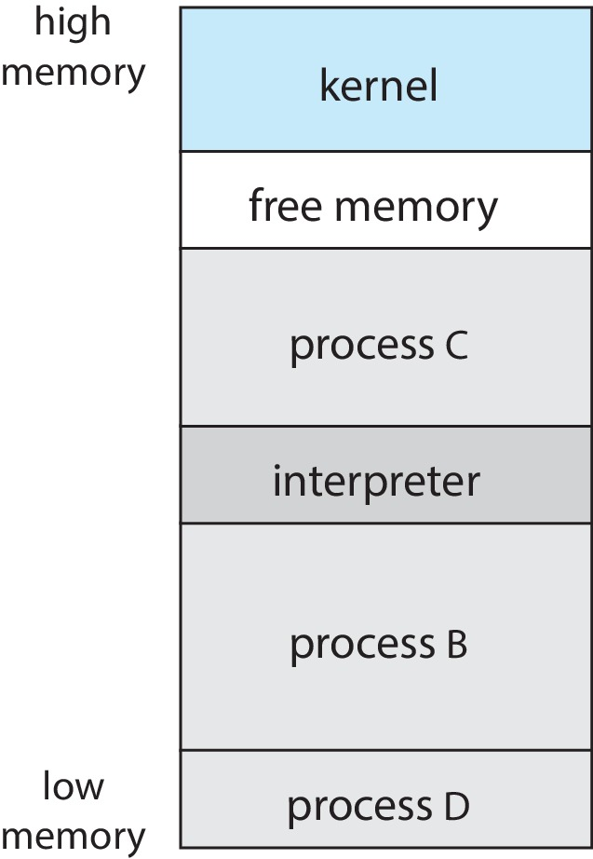
Example: FreeBSD
Unix variant
Multitasking
User login -> invoke user’s choice of shell
Shell executes fork() system call to create process
Executes exec() to load program into process
Shell waits for process to terminate or continues with user commands
Process exits with:
code = 0 – no error
code > 0 – error code

Slide 18
System Services
System programs provide a convenient environment for program development and execution. They can be divided into:
File manipulation
Status information sometimes stored in a file
Programming language support
Program loading and execution
Communications
Background services
Application programs
Most users’ view of the operation system is defined by system programs, not the actual system calls

Slide 19
System Services (Cont.)
Provide a convenient environment for program development and execution
Some of them are simply user interfaces to system calls; others are considerably more complex
File management - Create, delete, copy, rename, print, dump, list, and generally manipulate files and directories
Status information
Some ask the system for info - date, time, amount of available memory, disk space, number of users
Others provide detailed performance, logging, and debugging information
Typically, these programs format and print the output to the terminal or other output devices
Some systems implement a registry - used to store and retrieve configuration information

Slide 20
System Services (Cont.)
File modification
Text editors to create and modify files
Special commands to search contents of files or perform transformations of the text
Programming-language support - Compilers, assemblers, debuggers and interpreters sometimes provided
Program loading and execution- Absolute loaders, relocatable loaders, linkage editors, and overlay-loaders, debugging systems for higher-level and machine language
Communications - Provide the mechanism for creating virtual connections among processes, users, and computer systems
Allow users to send messages to one another’s screens, browse web pages, send electronic-mail messages, log in remotely, transfer files from one machine to another

Slide 21
System Services (Cont.)
Background Services
Launch at boot time
Some for system startup, then terminate
Some from system boot to shutdown
Provide facilities like disk checking, process scheduling, error logging, printing
Run in user context not kernel context
Known as services, subsystems, daemons
Application programs
Don’t pertain to system
Run by users
Not typically considered part of OS
Launched by command line, mouse click, finger poke

Slide 22
Linkers and Loaders
Source code compiled into object files designed to be loaded into any physical memory location – relocatable object file
Linker combines these into single binary executable file
Also brings in libraries
Program resides on secondary storage as binary executable
Must be brought into memory by loader to be executed
Relocation assigns final addresses to program parts and adjusts code and data in program to match those addresses
Modern general purpose systems don’t link libraries into executables
Rather, dynamically linked libraries (in Windows, DLLs) are loaded as needed, shared by all that use the same version of that same library (loaded once)
Object, executable files have standard formats, so operating system knows how to load and start them

Slide 23
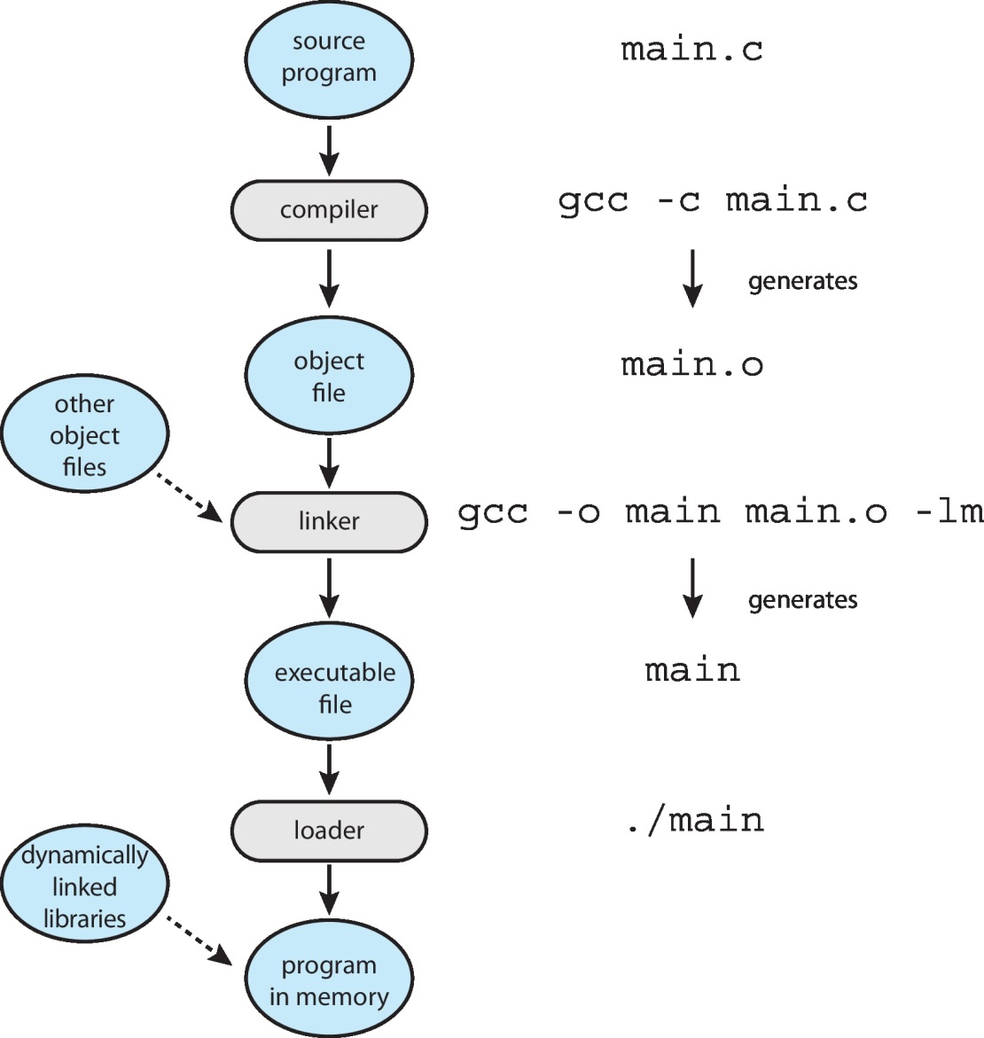
The Role of the Linker and Loader

Slide 24
Why Applications are Operating System Specific
Apps compiled on one system usually not executable on other operating systems
Each operating system provides its own unique system calls
Own file formats, etc.
Apps can be multi-operating system
Written in interpreted language like Python, Ruby, and interpreter available on multiple operating systems
App written in language that includes a VM containing the running app (like Java)
Use standard language (like C), compile separately on each operating system to run on each
Application Binary Interface (ABI) is architecture equivalent of API, defines how different components of binary code can interface for a given operating system on a given architecture, CPU, etc.

Slide 25
End of Chapter

